Slide 1


Blue Bird Group Story
Noni Purnomo – President Director of Blue Bird Group Holding

Slide 2
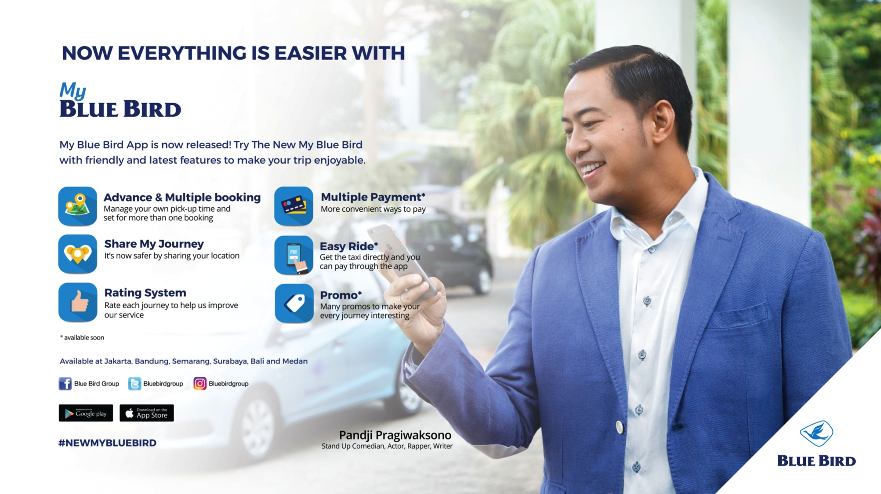

Slide 3
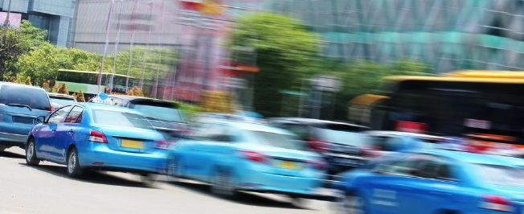
Current Challenges
Rapid technology transformation
Customers expectations
Expansion VS Corporate Culture
MEA & Globalization

Slide 4
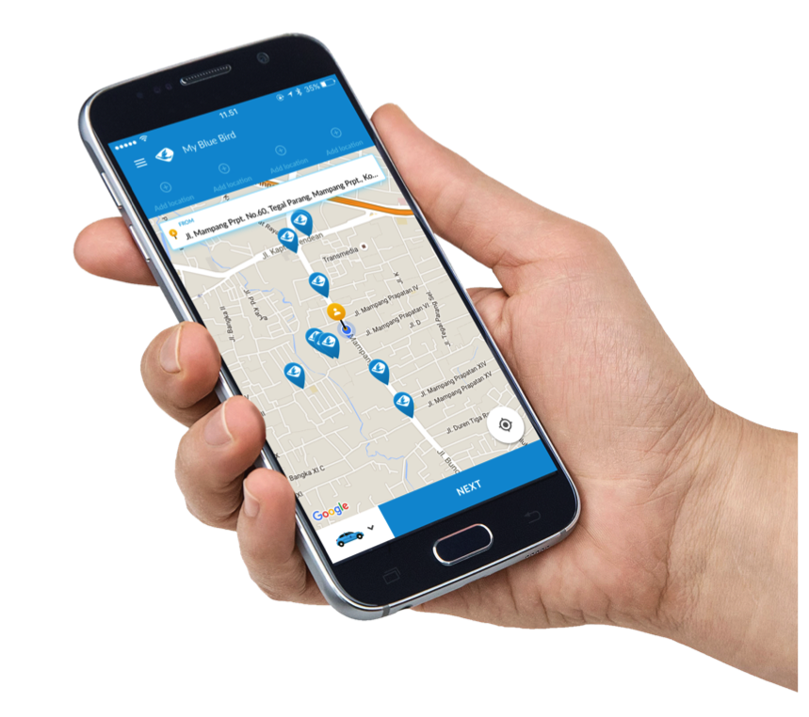
Our Focus to Overcome The Challenges
Internal
Corporate Culture & Values Review
Internal engagement & change management
Technology enhancement for internal stakeholders (drivers, management, etc).
External
More personalized approach to customers using technology and various programs (e.g loyalty).
Gain brand relevancy especially to the young affluent & millennial without losing the identity of Blue Bird.

Slide 5
What makes Blue Bird Group drivers
different?
Well-selected
45 %
Well-trained
Well-motivated
Notes:
Ibu akan berbicara pada sesi atau panel kedua (2) yang bertema, Facing Technological Challenges and Opportunities from Entrepreneurs Perspective, dengan alokasi waktu kurang lebih selama 15 menit. Dalam sesi ini kami berharap ibu Noni selaku pemimpin dari armada transportasi terdepan dan terkemuka di Indonesia dapat berbagi pengetahuan, pengalaman, strategi, taktik dan cerita sukses dari Blue Bird Group untuk terus bertahan dan meningkatkan kinerja perusahaan di era yang baru ini.

Slide 6
What makes Blue Bird Group drivers
really different?
Our respect and care toward each other as one big family

Slide 7
What makes Blue Bird Group drivers
really really different?
Trust and support by all of loyal customers

Slide 8
Thank You

